Slide 1
CT032-3-3-FAI-L-2 Further Artificial Intelligence
Introduction to Jupyter Notebook

Slide 2
TOPIC LEARNING OUTCOMES
At the end of this topic, you should be able to:
1. Install Python Anaconda
2. Setup development using Jupyter Notebook
3. Run basic Python code

Slide 3
Contents & Structure
Installation Guide
Run basic Python programme and libraries/packages

Slide 4
Recap From Last Lesson
Introduction to Artificial Intelligence

Slide 5
Python Anaconda Installation
The easiest way to install the Jupyter Notebook App is installing a scientific python distribution which also includes scientific python packages. The most common distribution is called Anaconda:
Download Anaconda Distribution (a few 100MB), Python 3, 64 bits.
URL: https://www.anaconda.com/products/distribution
Install it using the default settings for a single user.
Installation guide: https://docs.anaconda.com/free/anaconda/install/windows/

Slide 6
Step 1: Download Anaconda Installer
Anaconda3-2023.03-1-Windows-x86_64

Slide 7
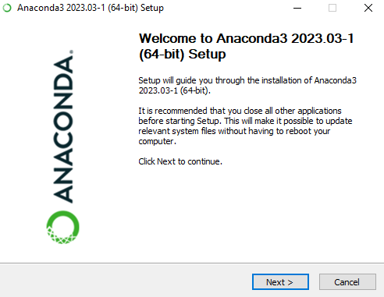
Step 2: Launch Installer
Click ‘Next’

Slide 8
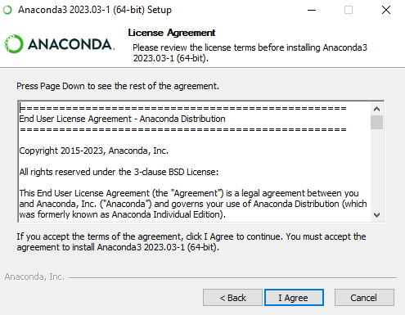
Step 3: License Agreement
Click ‘I Agree’ button

Slide 9
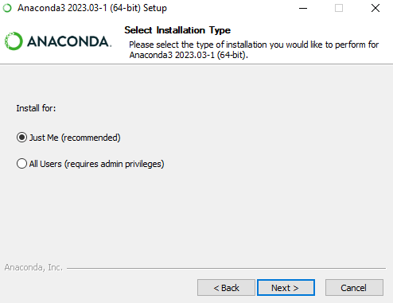
Step 4: Select Installation Type
Select “Just Me”
Click “Next”

Slide 10
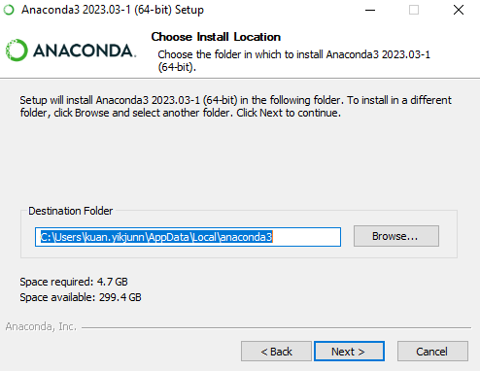
Step 5: Choose Install Location
Choose the directory of installation
Click ‘Next’

Slide 11
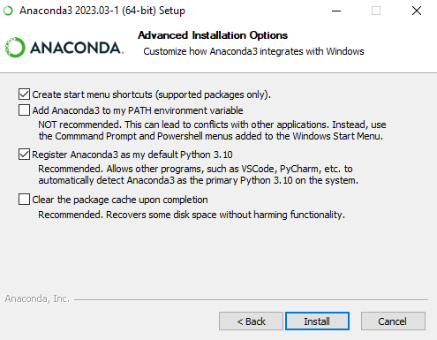
Step 6: Advanced Installation Options
Check on default settings (recommended)
Click ‘Install’

Slide 12
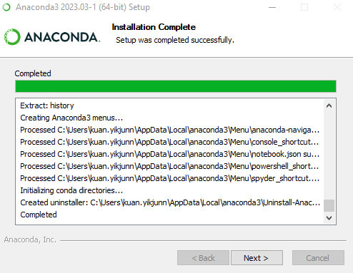
Step 7: Installation Process
Wait until installation complete
Click ‘Next’

Slide 13
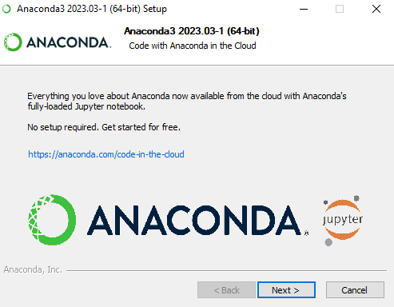
Step 8: Anaconda3
Click ‘Next’

Slide 14
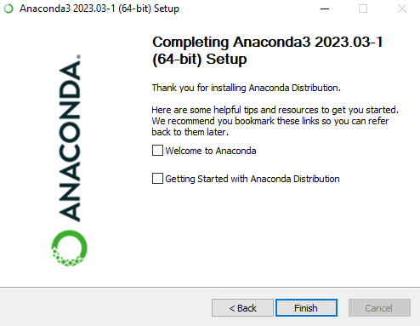
Step 9: Final Setup
Click ‘Finish’

Slide 15
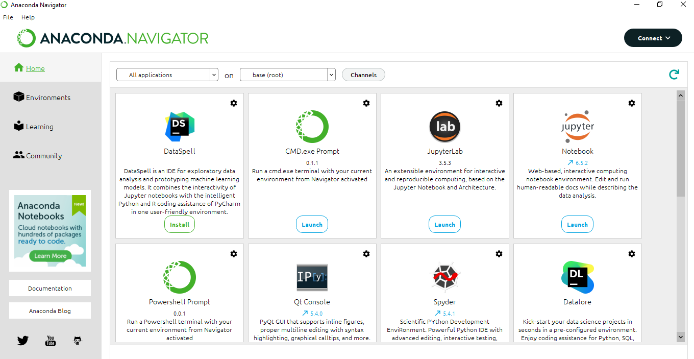
Anaconda environment
If you wanted to create new environment for new project:
Step 1: In your windows PC search for “Anaconda Navigator”
Step 2: Go to ‘Environments’ tab
Step 3: Click ‘Create’ to create new environment
Step 4: Enter the name of new environment and click ‘Create’

Slide 16
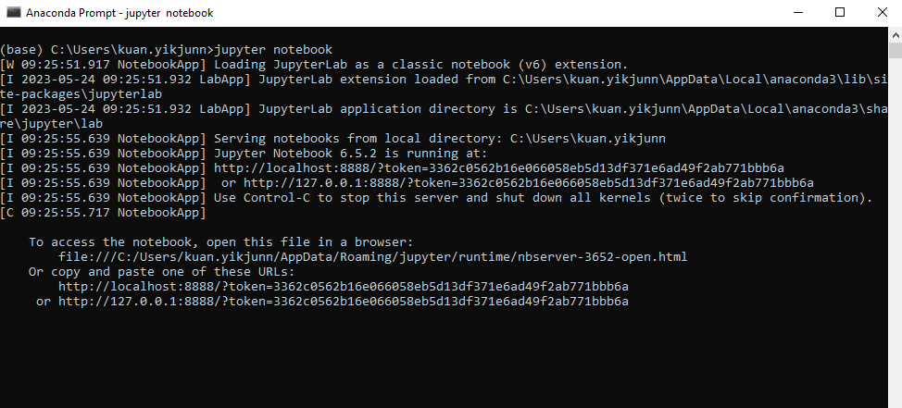
Launch Jupyter Notebook
Step 1: In your PC, search “Anaconda Prompt” cmd
Step 2: Select directory of your project path
Step 3: Type “jupyter notebook” and press ‘Enter’ in cmd

Slide 17
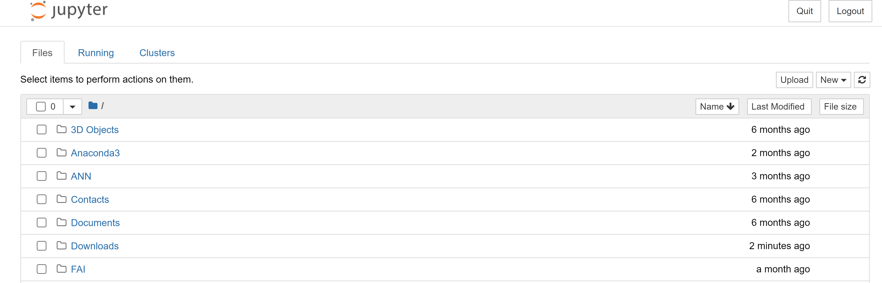
Running Jupyter Notebook
You should see notebook running on your browser

Slide 18
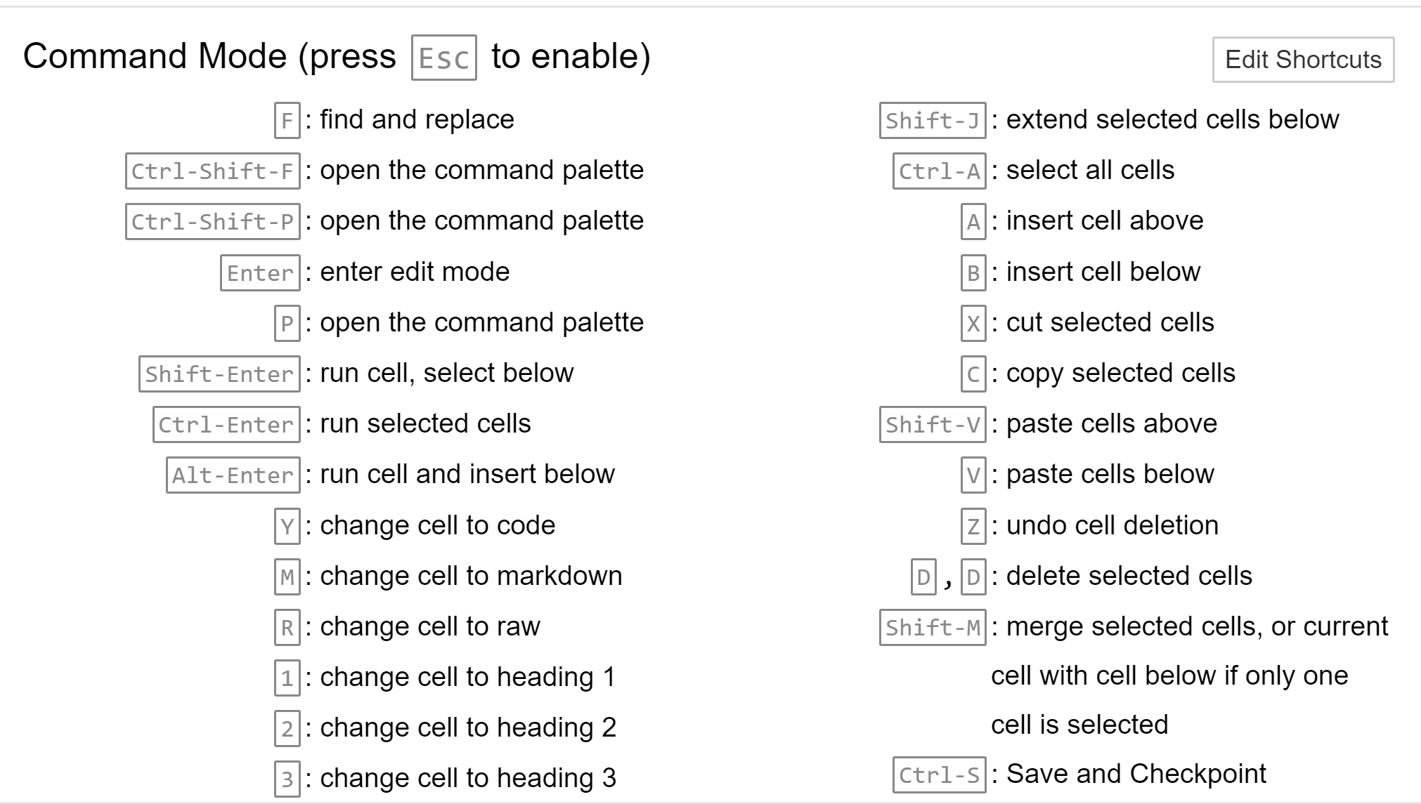
Jupyter Notebook Command
The Jupyter command can also be used to do actions.

Slide 19
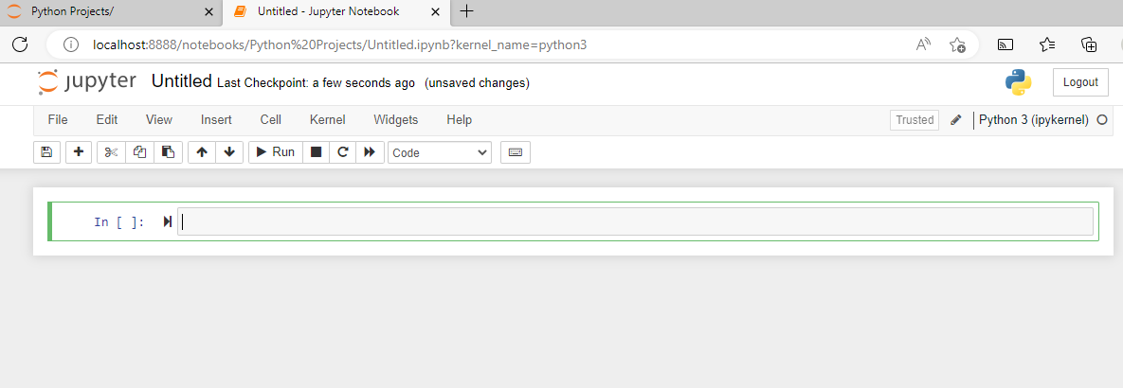
Getting Started with Jupyter Notebook
Click ‘New’ then “Python 3 (ipykernel)”

Slide 20
Library (Numpy)
NumPy (Numerical Python) is an open-source Python library working with numerical data in python.
The NumPy API is used extensively in Pandas, SciPy, Matplotlib, scikit-learn, scikit-image and most other data science and scientific Python packages.
The NumPy library contains multidimensional array and matrix data structures which are to provide ndarray, a homogeneous n-dimensional array object, with methods to efficiently operate on it.
NumPy also will be used to perform a wide variety of mathematical operations on arrays.

Slide 21
Library (Numpy)
If you already have Python, you can install NumPy with:
conda install numpy
pip install numpy
If using anaconda platform, you don’t need to worry too much about separately installing NumPy or any of the major packages that you’ll be using for your data analyses, like pandas, Scikit-Learn, etc.
Import numpy as library:
import numpy as np

Slide 22
Basic array
To create a NumPy array, you can use the function np.array(). All you need to do to create a simple array is pass a list to it. If you choose to, you can also specify the type of data in your list.
Sorting an element is simple with np.sort(). You can specify the axis, kind, and order when you call the function. If you start with this array.
You can quickly sort the numbers in ascending order with:
import numpy as np
a = np.array([1, 2, 3])
arr = np.array([2, 1, 5, 3, 7, 4, 6, 8])
np.sort(arr)
array([1, 2, 3, 4, 5, 6, 7, 8])

Slide 23
Tutorials on array with Numpy
Open Command prompt and open jupyter notebook
Create a new folder and create a new kernel. Rename your file.
Import numpy as library:
import numpy as np
Create an array list
my_list = [1,2,3]
my_list
Print the array list
np.array(my_list)
Create a new array named as my_matrix, the view the new list of array.
my_matrix = [[1,2,3],[4,5,6],[7,8,9]]
my_matrix
Print the new array list
np.array(my_matrix)
Use the function arrange for the following method:
np.arange(0,10)
output:

Slide 24
Tutorials on array with Numpy
np.arange(0, 11, 2)
output:
np.zeros(3)
output:
np.zeros((5, 5))
output:
array([ 0, 2, 4, 6, 8, 10])
array([0., 0., 0.])
array([[0., 0., 0., 0., 0.], [0., 0., 0., 0., 0.], [0., 0., 0., 0., 0.], [0., 0., 0., 0., 0.], [0., 0., 0., 0., 0.]])

Slide 25
Numpy operations
Create new list of array:
arr = np.arange(0,10)
Try the basic arithmetic operation below:
arr + arr
arr * arr
arr – arr
arr**3
np.sqrt(arr)
Output:

Slide 26
Library (Pandas)
What is Pandas?
Pandas is an open source library which helps you analyse and manipulate data
Why Pandas?
pandas provides a simple to use but very capable set of functions you can use to on your data.
It's integrated with many other data science and machine learning tools which use Python so understanding it will be helpful throughout your journey.
One of the main use cases you'll come across is using pandas to transform your data in a way which makes it usable with machine learning algorithms.

Slide 27
Library (Pandas)
Importance of Pandas
Calculate statistics and answer questions about the data, like:
What's the average, median, max, or min of each column?
Does column A correlate with column B?
What does the distribution of data in column C look like?
Clean the data by doing things like removing missing values and filtering rows or columns by some criteria
Visualize the data with help from Matplotlib. Plot bars, lines, histograms, bubbles, and more.
Store the cleaned, transformed data back into a CSV, other file or database.

Slide 28
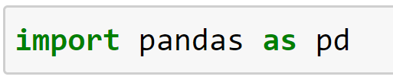
Import pandas library
To get started using pandas, the first step is to import it.
The most common way (and method you should use) is to import pandas as the abbreviation pd.
If you see the letters pd used anywhere in machine learning or data science, it's probably referring to the pandas library.
Write a declaration of importing library as below:

Slide 29
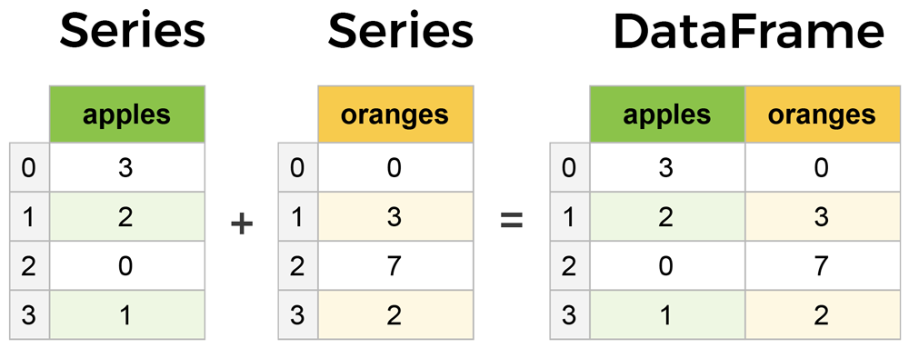
Core components of pandas: Series and DataFrame
The primary two components of pandas are the Series and DataFrame.
A Series is essentially a column
DataFrame is a multi-dimensional table made up of a collection of Series.

Slide 30
Series and DataFrame
Let's say we have a fruit stand that sells apples and oranges.
We want to have a column for each fruit and a row for each customer purchase.
To organize this as a dictionary for pandas we could do something like:
And then pass it to the pandas DataFrame constructor:
Output:
data = { 'apples': [3, 2, 0, 1], 'oranges': [0, 3, 7, 2] }
purchases = pd.DataFrame(data) purchases

Slide 31
Series and DataFrame
Let's have customer names as our index:
Output:
So now we could locate a customer's order by using their name:
Output:
purchases = pd.DataFrame(data, index=['June', 'Robert', 'Lily', 'David']) purchases
purchases.loc['June']

Slide 32
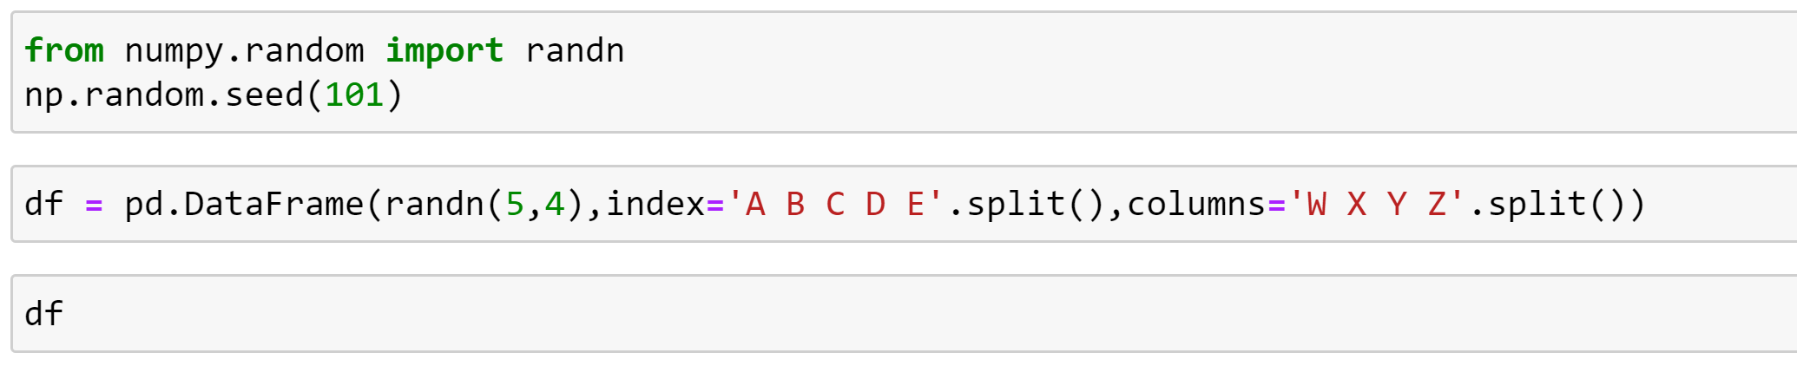
Data Frame
DataFrame as a bunch of Series objects put together to share the same index.
Output:

Slide 33
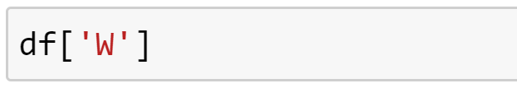
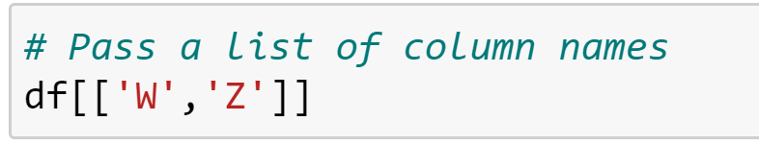
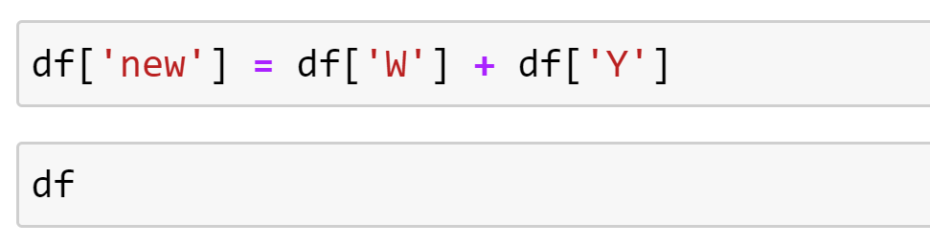
DataFrame
Selection and indexing:
Syntax : df [columnsname]
Create column list:
Create a new column:
Drop columns:
df.drop('new',axis=1)
Removing rows:
df.drop('E',axis=0)

Slide 34
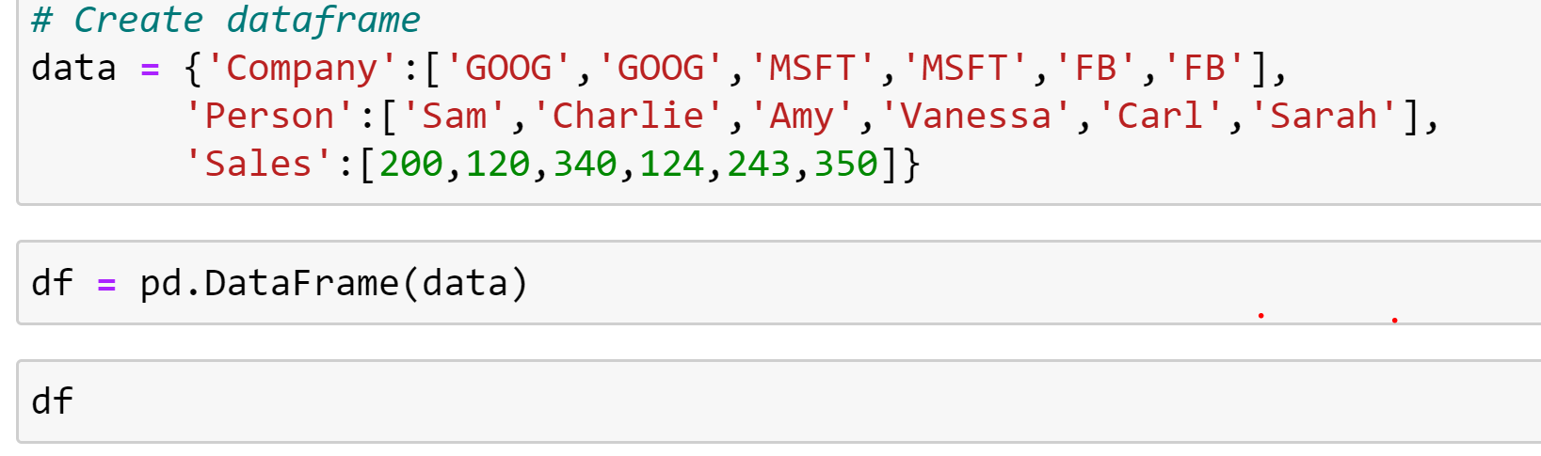
DataFrame
Group by
The groupby method allows you to group rows of data together and call aggregate functions.
The following are steps:
Create the data frame
Store list of data to frame
Print/view the list.
Sample code

Slide 35
Review Questions
What is the difference between Series and DataFrame?

Slide 36
Summary / Recap of Main Points
Installation of Python Anaconda
Setup Jupyter Notebook
Basic codes on Python using Jupyter Notebook

Slide 37
What To Expect Next Week
In Class
Preparation for Class
Machine Learning
Concepts of Machine Learning

